Slide 1
Project Report Group 6
Predicting Injury Severity in Road Accidents – A Real-Time Classification Approach
David Cebulla, Gabriel Himmelein, Lukas Ott, Artur Loreit, Aaron Niemesch

Slide 2






Application Area and Goals
Predict severity. Speed up rescue. Save lives.
eCall sends emergency call including time, location and number of passengers
Problem definition:
Delay due to manual accident classification
Errors in assessing the severity of an accident
⇒ Saving time and improving accuracy can save lives
Accident severity is only recognized once on site
Control center evaluates emergency call manually

Slide 3
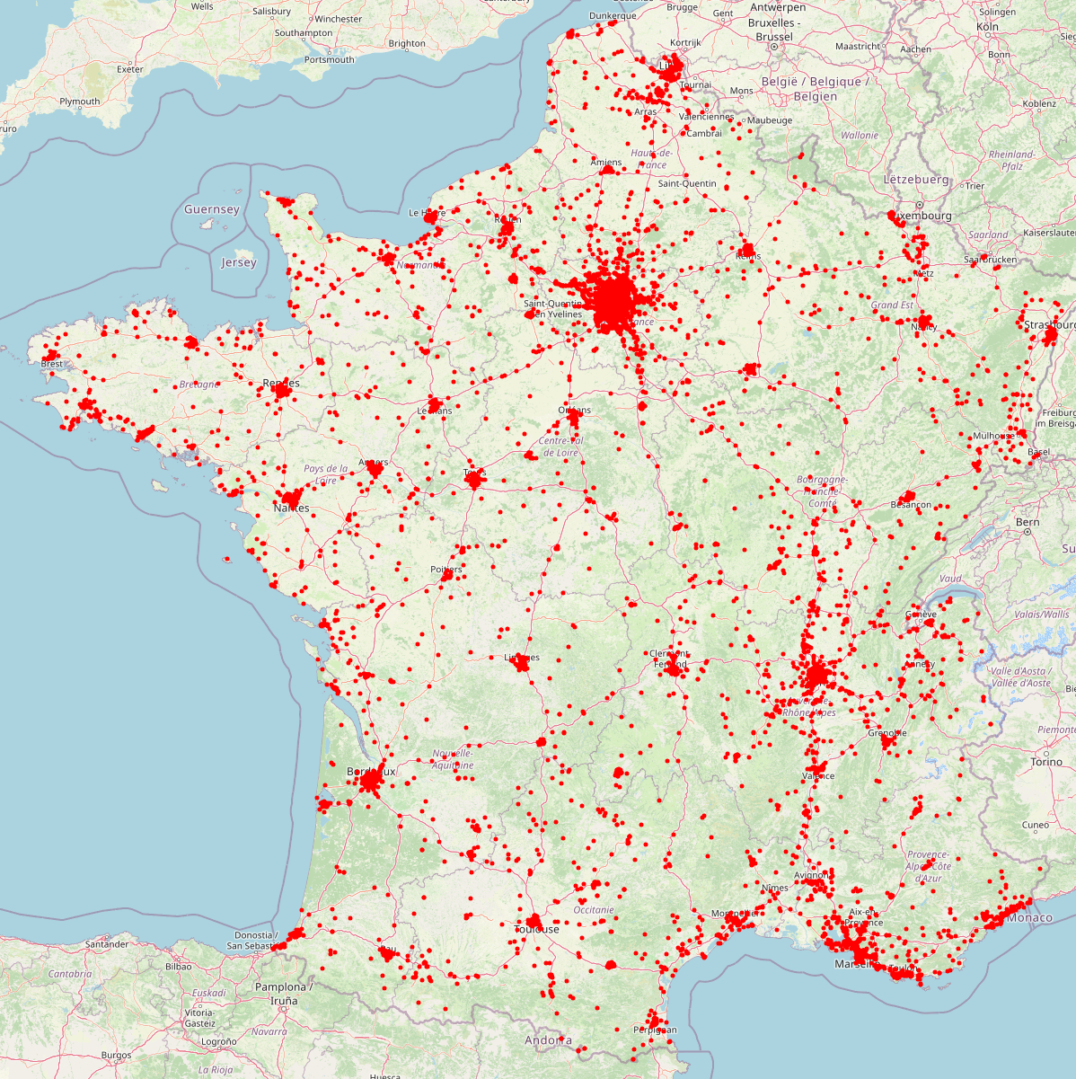






Structure and Size of Data Set
„Annual Road Traffic Injury Database“ by ONISR
Dataset evaluation:
Files | 4 per year (characteristics, locations, users, vehicles)
Target | Individual level of severity
Train set | 493.214 (2019-22)
Test set | 125.505 (2023)
Features | 71 original features
Used Features | 23 original, 34 engineered features

Slide 4









Structure and Size of Data Set
Included Aspects and Features in Final Data Set
Feature Descriptions:
Time Context | Includes time of day categories
Geospatial | GPS coordinates
Environment | Physical site attributes with risk-based ordinals
Crash dynamics | Collision mechanics
Vehicle attributes | Specifies primary vehicle type
Personal attributes | Demographic data
Safety Equipment | Use of protective gear
Clustering | Accident personas
Target | Ordinal target (0,1,2)

Slide 5
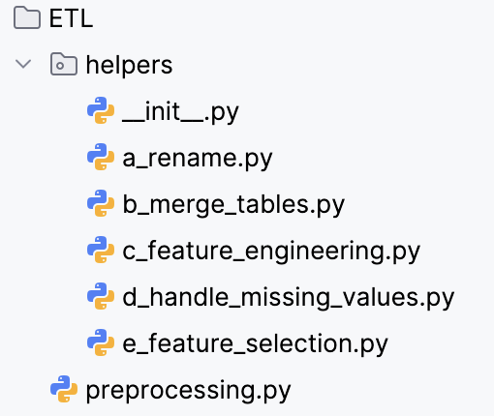
Preprocessing
Data Merging Strategy
Data standardization strategy
Engineered features:
Creation of synthetic user_id for the years 2019 and 2020
(1) Vehicle antagonist resolution:
Impact score to vehicle categories based on mass and risk (e.g., HGV Truck = 6, Bicycle = 2)
Highest scoring antagonist vehicle encoded into record
(2) Location deduplication:
Weighted completeness score assessment for most data-rich description of scene
(Road Category: 2.0, Speed Limit: 2.0, others: 1.0)

Slide 6
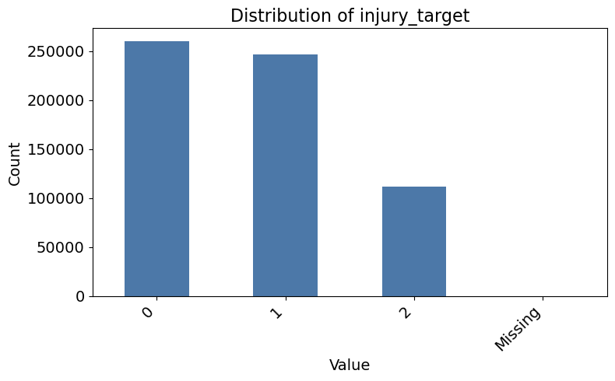
Preprocessing
Data Merging Strategy
Feature selection and cleaning
Engineered features
Encoding of target value
Imputation of structural missingness
Actual missing values: 0 or 'Unknown'
Pedestrian and antagonist cases: -1 or 'none'
Columns were dropped with at least 5% missing values
Temporal features
Road complexity index
Bucketing of vehicle and user attributes
Severe injury and death were put in the same category

Slide 7


Data Mining
Categories of algorithms considered
*Rebalancing Required
Ordinal
Ordinal-IT
Ordinal-AT
SVM
SVC
LinearSVC
SDGClassifier + Nystroem
ANN
MLPClassifier
Boosting
Bagging
Regression
CatBoost
HistGradientBoosting
GradientBoosting
AdaBoost
LightLGM
BalancedRandomForest
BalancedBaggingClassifier
EasyEnsembleClassifier
RidgeClassifier
RidgeRegression
LassoRegression
CatBoostRegression

Slide 8
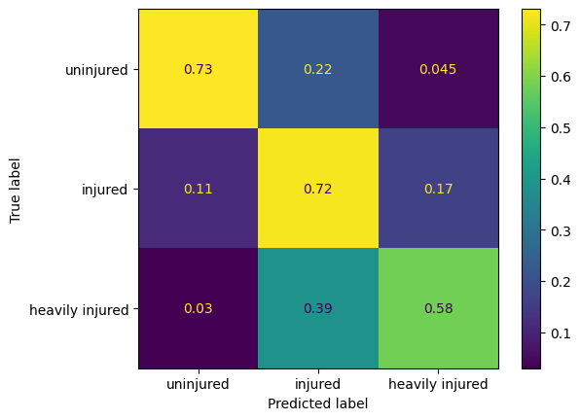
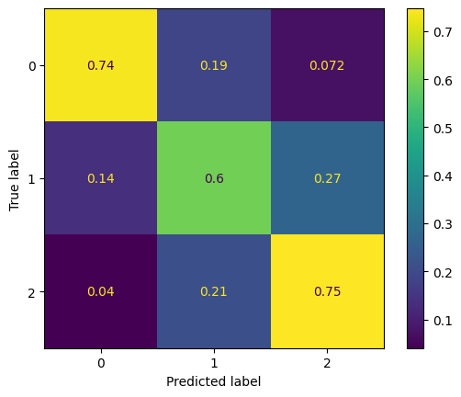
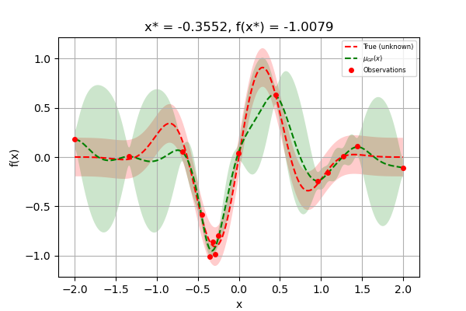
Data Mining
Model Selection
F1-Makro: ≈ 0.7
3-fold Cross Validation
Reason: Dataset Large (>430k), Resampling (130k)
Tradeoff between Precision and Computation Time
Alternative: Separate Validation Set
F1-Macro (Optimization Target)
Equal Weight for all Classes irrespective of Distribution
Important: only used after checking for ordinal performance
Confusion Matrices used to check for Error Types
Check Recall for Severly Injured
Generated using [cross-val-predict]
Hyperparameter Tuning: Bayesian Optimization
Dataset Size: Reduce Computation Time
E.g.: CatBoost Hyperparameter Training: 1h 40min (on GPU!)

Slide 9
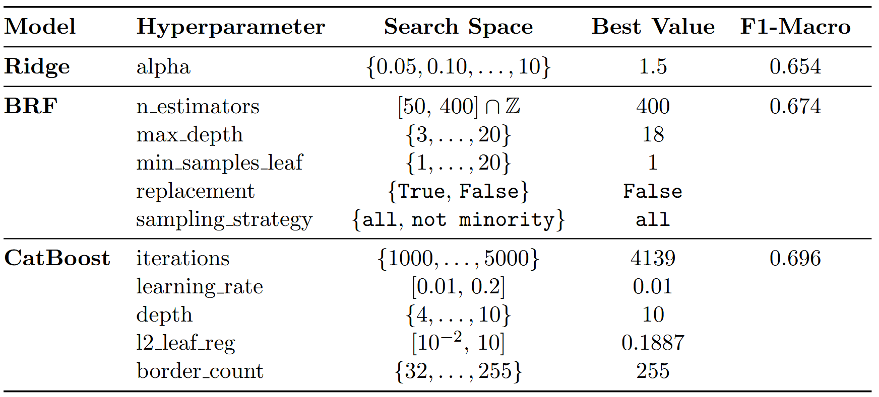
Data Mining
Hyperparameter Tuning

Slide 10
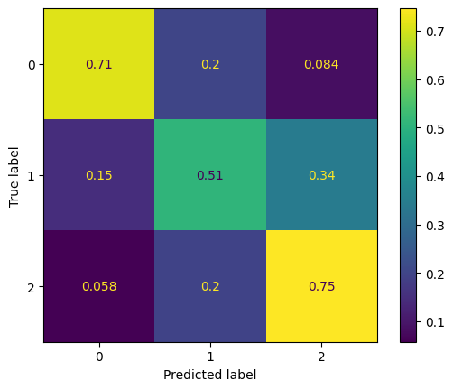
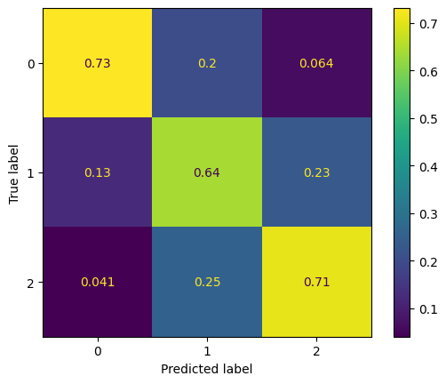
Data Mining
Model Selection: Results
RidgeClassifier
F1-Macro: 0.65
BalancedRandomForest
F1-Macro: 0.66
CatBoost
F1-Macro: 0.7
y_pred_cat_cross_val2 = cross_val_predict(cat_classifier_cross_val2, X_train_rebalanced, y_train_rebalanced, cv=cv)
print(classification_report(y_train_rebalanced, y_pred_cat_cross_val2))
ConfusionMatrixDisplay(confusion_matrix(y_train_rebalanced, y_pred_cat_cross_val2, normalize='true')).plot()
Only model selection: no generalization performance!

Slide 11


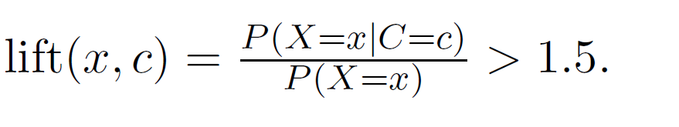

Data Mining - Clustering
Goal: Identification of distinct accident personas
Approaches: K-Prototypes, HDBSCAN, Agglomerative Clustering
Criteria for Profiling:
Lift filter: A minimum overrepresentation
Support filter: minimum total representation in the cluster
Dominance filter: Exclude dominant features

Slide 12
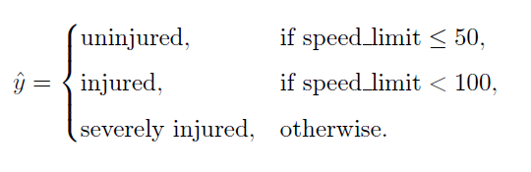
Evaluation Setup
Test Set: Full 2023 dataset
107,967 records
Distribution:
Non-Injured 47%
Injured 37%
Severly Injured 16%
Domain Baseline

Slide 13
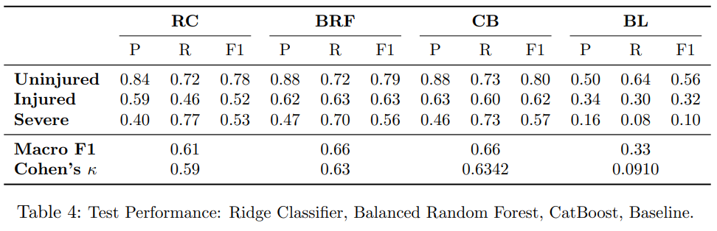
Results Model Comparison (1)
CatBoost and Balanced Random Forest perform best!

Slide 14
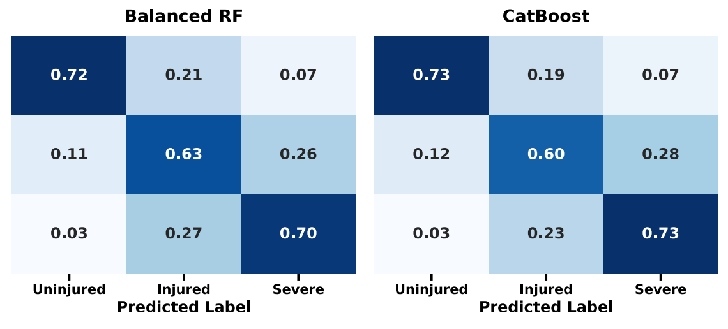
Results Model Comparison (2)
Catboost has the higher recall for the "severe" - class
This is desirable, since a misclassification of a severe case can be fatal
Therefore, Catboost yields the best results

Slide 15
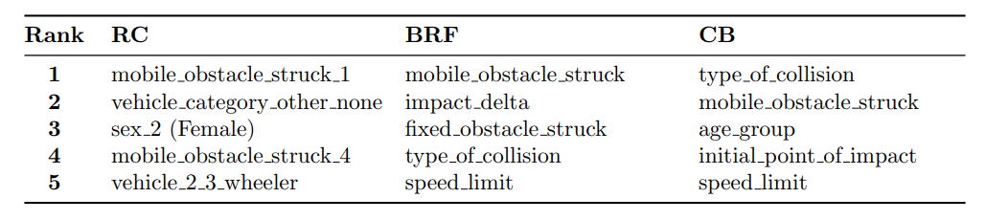
Results Feature Importance
Nature of the obstacle struck critical for injury prediction
Variables such as type of collision and initial point of impact highlight the importance of the precise point of impact for prediction
Speed limit is also a relevant feature, as higher speeds lead to more severe injuries

Slide 16





Results Accident Personas
Persona 1
Persona 2
Persona 3
Midday
Older road users
Urban areas
Night-time
Younger adults
Low visibility
Morning rush-hour
Commuter traffic / Congestions
Persona 4
Persona 5
High speed
Pedestrian involvement
Low-speed
Urban areas
No safety belt

Slide 17
Thank You For Your Attention

Slide 18
Structure and Size of Data Set
Included Aspects and Features in Final Data Set
Aspect | Description
Time Context | Includes time of day categories
Geospatial | GPS coordinates
Environment | Physical site attributes with risk-based ordinals
Crash dynamics | Collision mechanics
Aspect | Description
Vehicle attributes | Specifies primary vehicle type
Personal attributes | Demographic data
Safety equipment | Use of protective gear
Clustering | Accident personas
Target | Ordinal target (0,1,2)

Slide 19
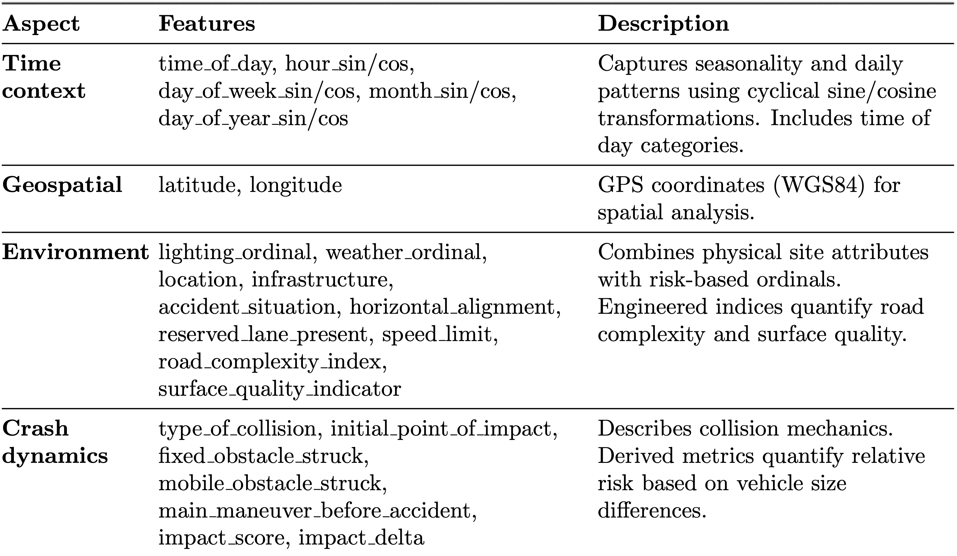
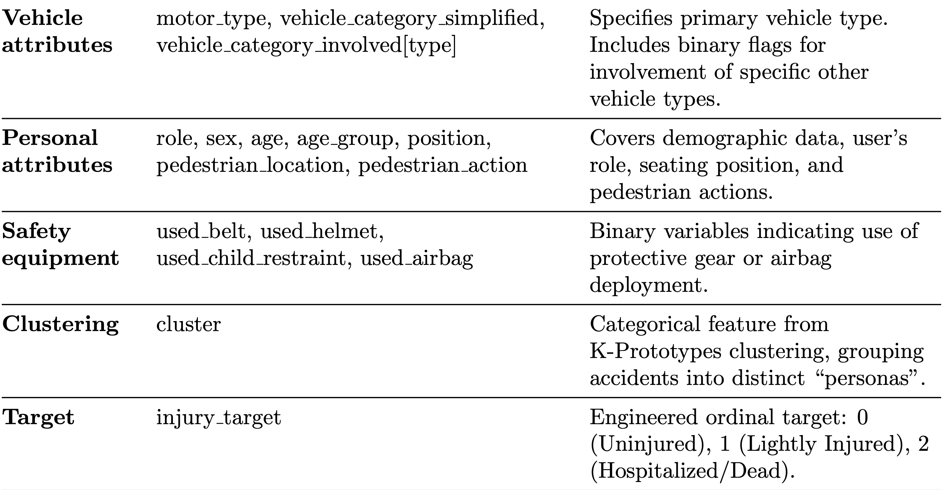
Structure and Size of Data Set
Included Aspects and Features in Final Data Set

Slide 20
Preprocessing
Data Merging Strategy
Data standardization strategy:
Creation of synthetic user_id for the years 2019 and 2020
Advanced data merging strategies:
Vehicle antagonist resolution:
Impact score to vehicle categories based on mass and risk (e.g., HGV Truck = 6, Bicycle = 2)
Highest scoring antagonist vehicle encoded into record
Location deduplication:
Weighted completeness score assessment for most data-rich description of scene
(Road Category: 2.0, Speed Limit: 2.0, others: 1.0)

Slide 21
Preprocessing
Feature Selection & Engineering
Feature selection and cleaning:
Imputation of structural missingness
Actual missing values: 0 or 'Unknown'
Pedestrian and antagonist cases: -1 or 'none'
Columns were dropped with at least 5% missing values
Engineered features:
Temporal features
Road complexity index
Bucketing of vehicle and user attributes
Encoding of target value: severe injury and death were put in the same category

Slide 22
Data Mining
Categories of algorithms considered:
Rebalancing Required
Ordinal
Ordinal-IT
Ordinal-AT
SVM
SVC
LinearSVC
SDGClassifier + Nystroem
ANN
MLPClassifier
Boosting
CatBoost
HistGradientBoosting
GradientBoosting
AdaBoost
LightLGM
Bagging
BalancedRandomForest
BalancedBaggingClassifier
EasyEnsembleClassifier
Regression
RidgeClassifier
RidgeRegression
LassoRegression
CatBoostRegression

